Slide 1
DOROTA
PRIMARY SCHOOL 82 IN CRACOW

Slide 2
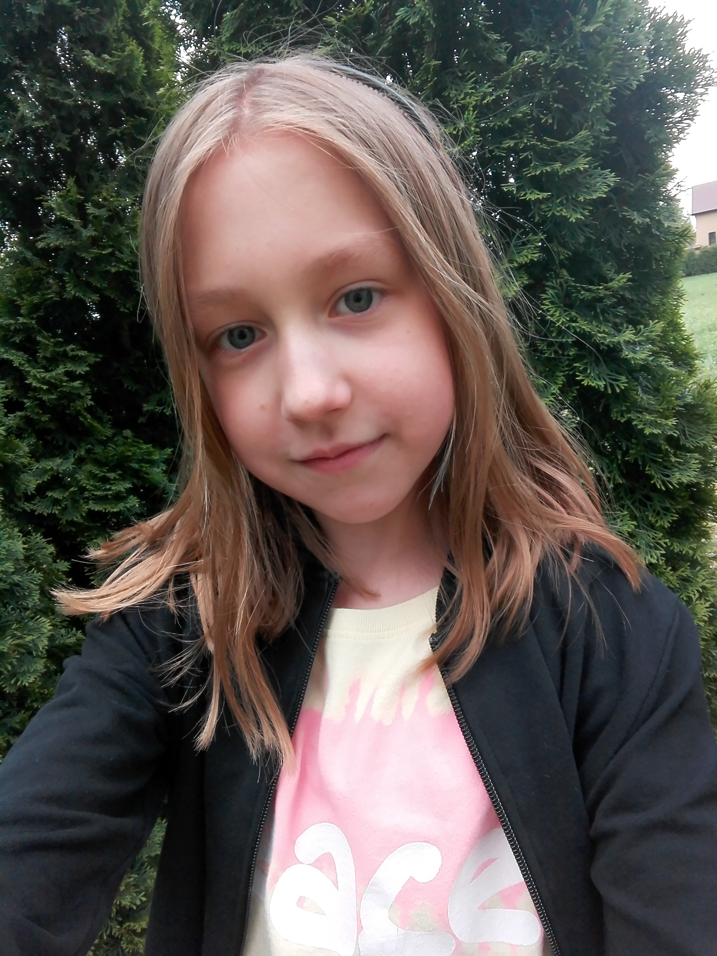
IT’S ME

Slide 3
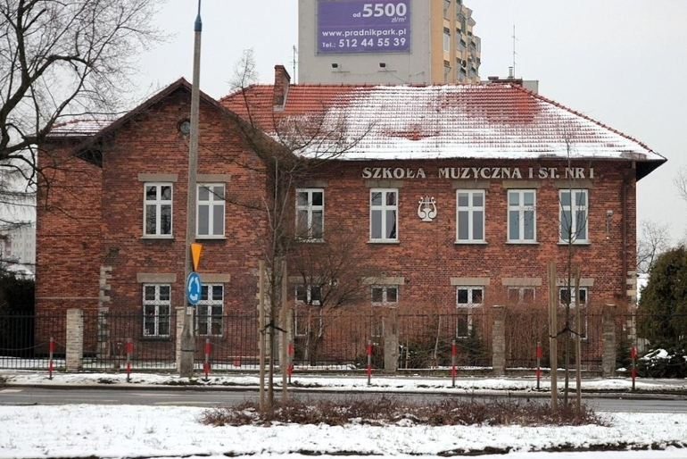
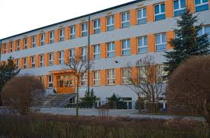
I GO TO SCHOOL EVERYDAY
Primary school Music school

Slide 4
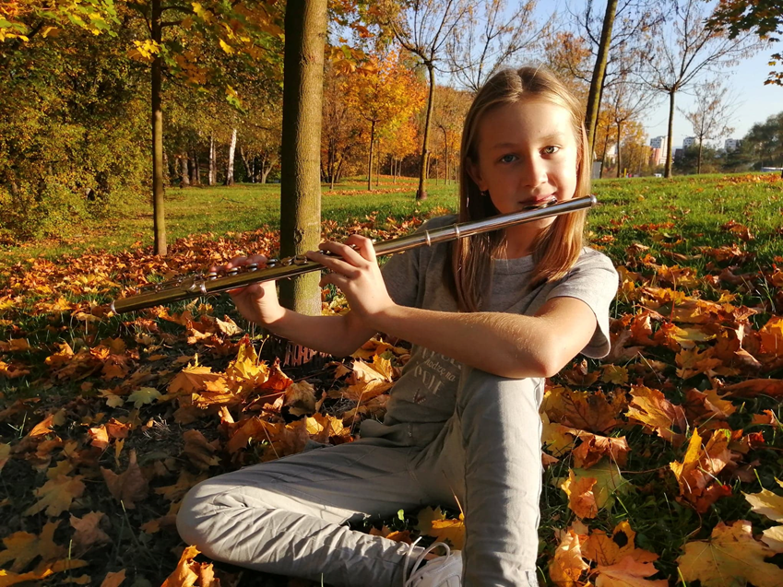
I LIKE TO PLAY THE FLUTE

Slide 5
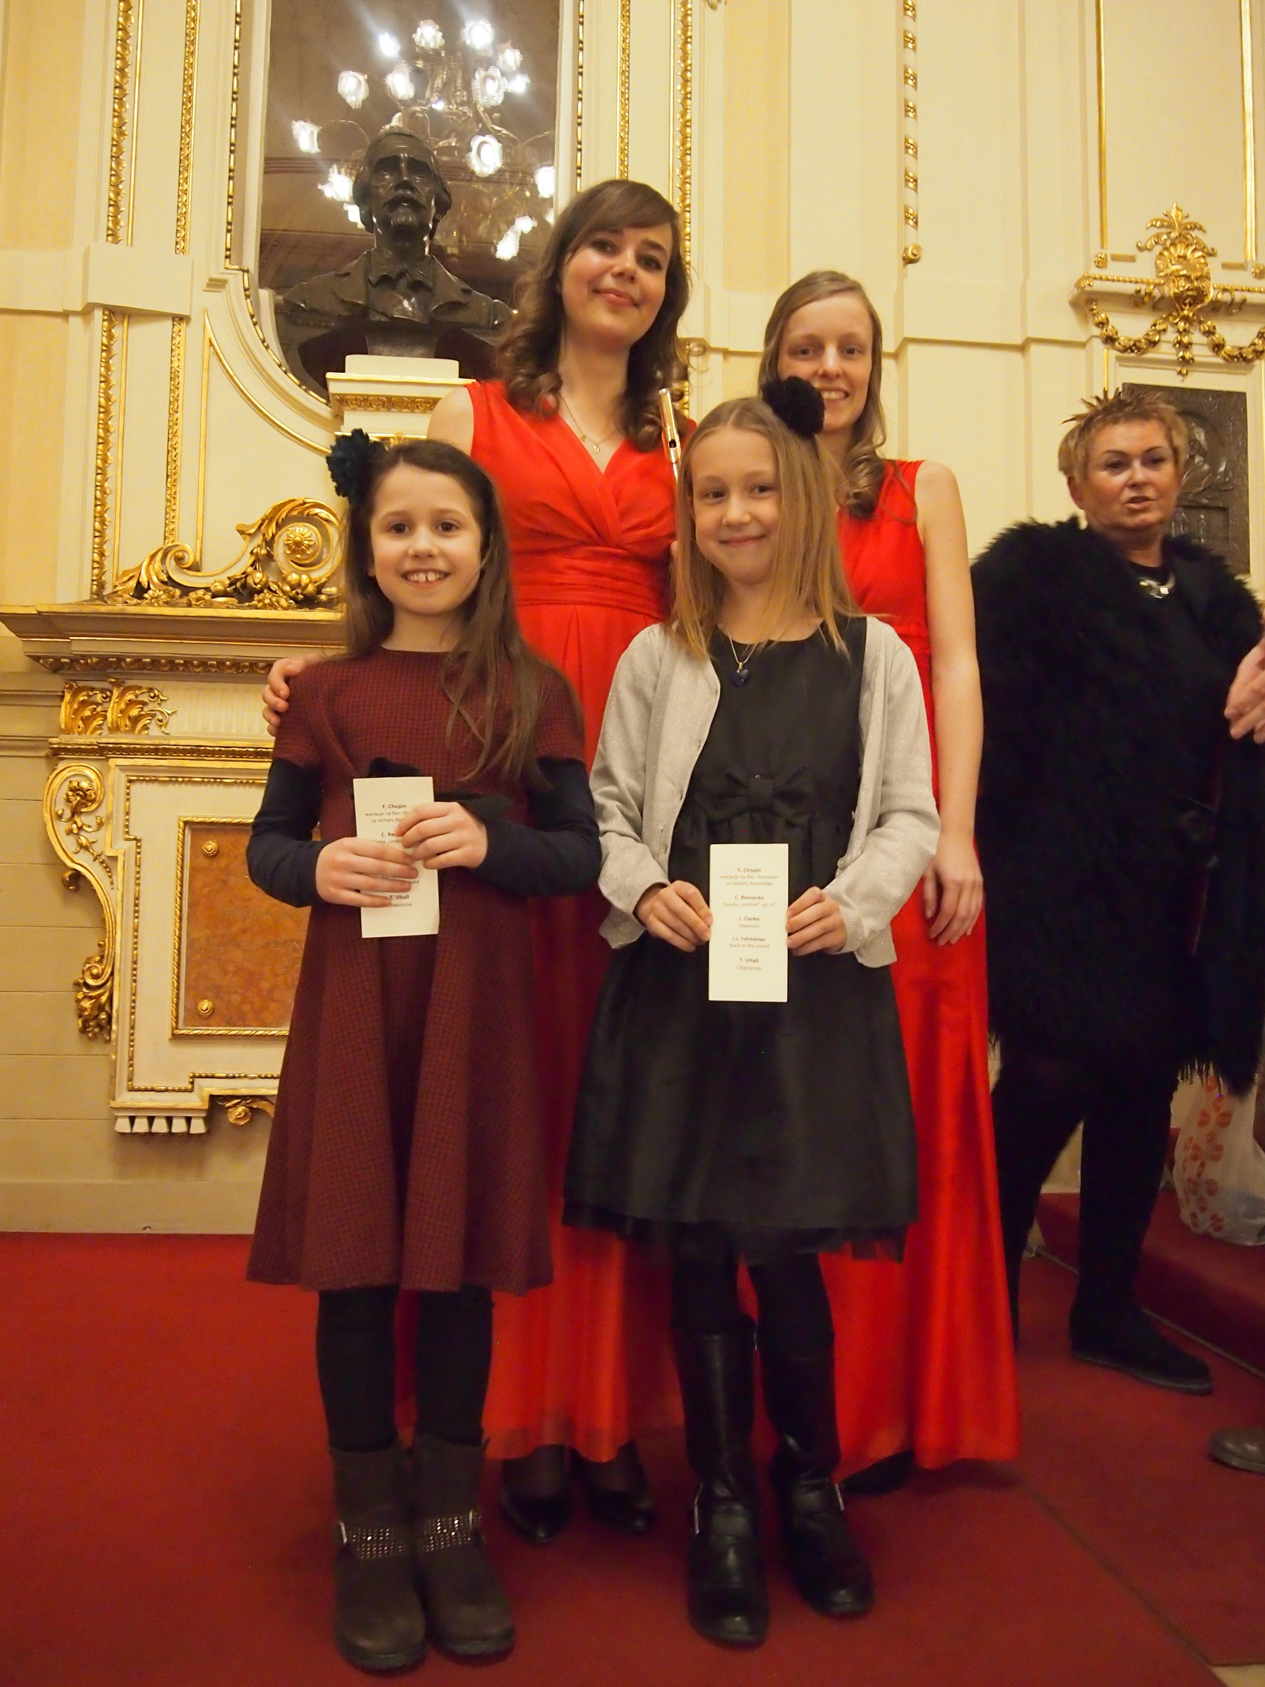
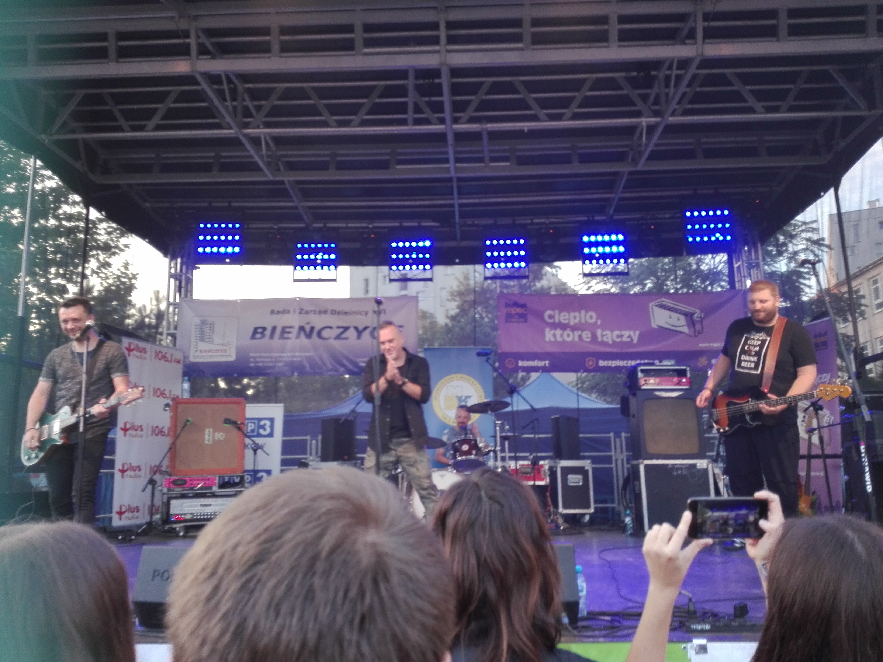
Sometimes
I go to theatre and to concerts

Slide 6
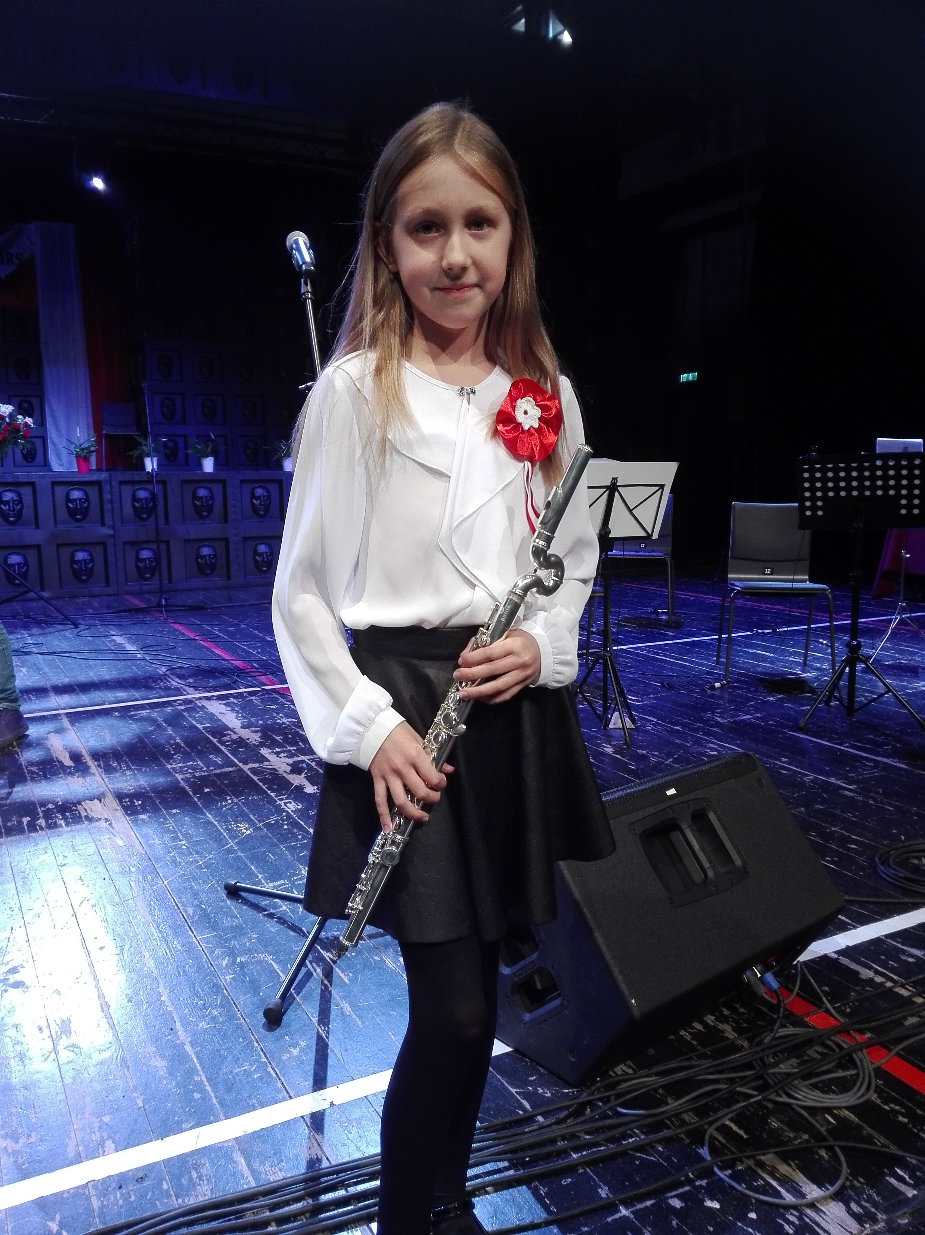
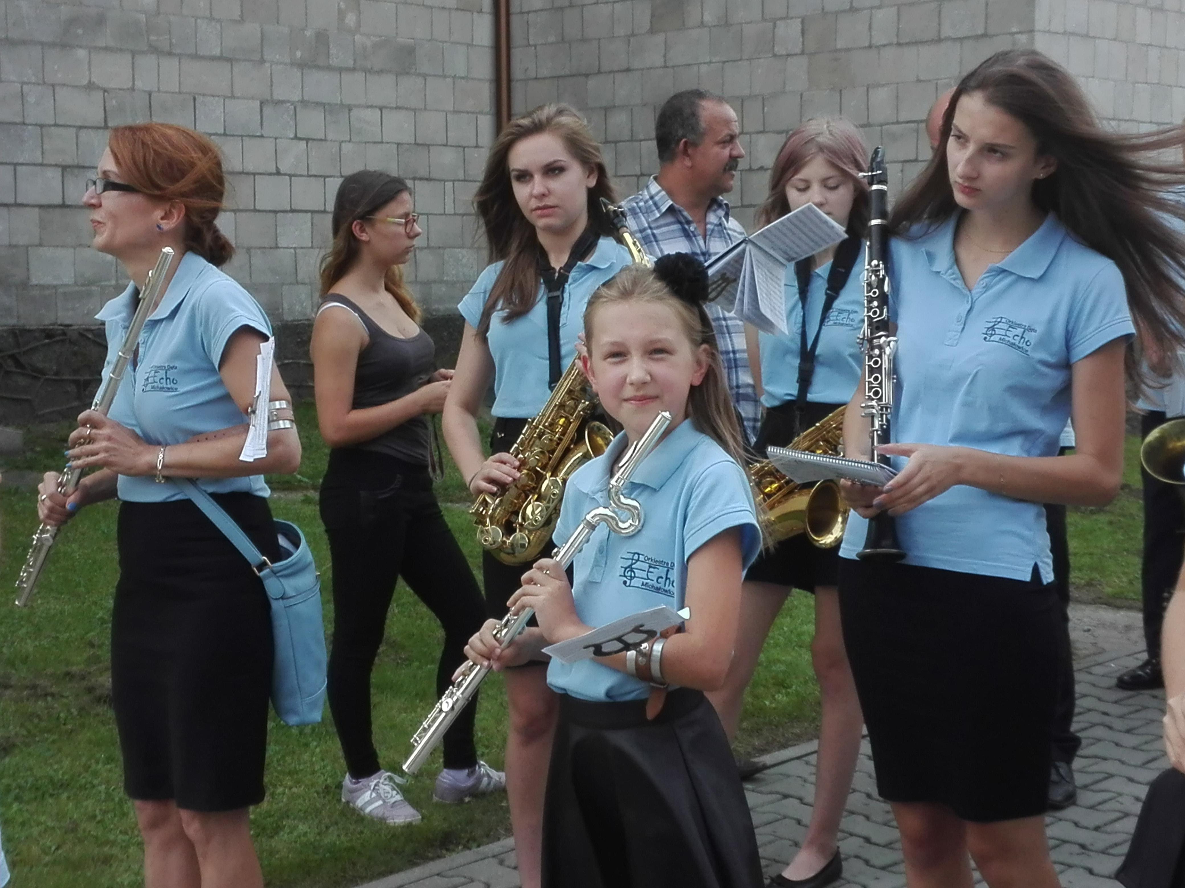
I play solo or with an orchestra

